Slide 1




CS646: OWL Tutorial (session 2)
Presented by the CO-ODE and HyOntUse projects
Funded by

Slide 2
CS646: This session
Issue: Primitive Classes & Polyhierarchies
Advanced: Reasoning
Advanced: Creating Defined Classes
Union Classes: Covering Axioms
Example: Creating a Vegetarian Pizza
Issue: Open World Assumption
Union Classes: Closure

Slide 3
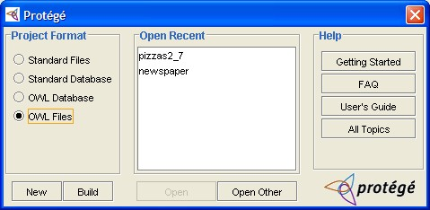
Loading OWL files from scratch
Run Protégé.exe
If you’ve only got an
OWL file:
Select “OWL Files” as the
Project Format, then “Build”
to select the .owl file
If you’ve got a valid project file*:
Select “OWL Files” as the Project Format, and then “Open Other” to find the .pprj file (if you’ve already opened it, it will be in “Open Recent”)
Open C:\Protégé_3.0_beta\examples\pizzas\pizzas2_0.owl
* ie one created on this version of Protégé - the s/w gets updated once every few days, so don’t count on it unless you’ve created it recently– safest to build from the .owl file if in doubt

Slide 4
Primitive Classes
All classes in our ontology so far are Primitive
We describe primitive pizzas
Primitive Class = only Necessary Conditions
They are marked as yellow in the class hierarchy
We condone building a disjoint tree of primitive classes

Slide 5
Describing Primitive Pizza Classes
Start with pizzas2_0.owl
Create a new pizza under NamedPizza
either choose from the menu or make it up
Create a new Existential (SomeValuesFrom) Restriction with the hasTopping property and a filler from PizzaTopping (eg HamTopping)
Add more Restrictions in the same way to complete the description
each restriction is added to an intersection –
so a Pizza must have toppingA and must have toppingB etc
see MargheritaPizza for an example
Create another pizza that has at least one meat ingredient
remember disjoints

Slide 6
Polyhierarchies
By the end of this tutorial we intent to create a VegetarianPizza
Some of our existing Pizzas should be types of VegetarianPizza
However, they could also be types of SpicyPizza or CheeseLoversPizza
We need to be able to give them multiple parents

Slide 7
Vegetarian Pizza attempt 1
Start with pizzas2_1.owl
Create a new pizza called
“VegetarianPizza” under Pizza
make this disjoint from its siblings as we have been doing
Select MargheritaPizza
you will notice that it only has a single parent, NamedPizza
Add VegetarianPizza as a new parent using the conditions widget “Add Named Class” button
notice that MargheritaPizza now occurs in 2 places in the asserted hierarchy
we have asserted that MargheritaPizza has 2 parents

Slide 8
Reasoning
We’d like to be able to check the logical consistency of our model
We’d also like to make automatic inferences about the subsumption hierarchy. A process known as classifying
  ie Moving classes around in the hierarchy based on their logical definition
Generic software capable of these tasks are known as reasoners (although you may hear them being referred to as Classifiers)
RACER is a reasoner

Slide 9
Running Racer
Open C:\Protégé_3.0_beta
Run racer.exe
A cmd window will open and two “service enabled” messages will appear in the ouput
Racer is now ready for use as an http server using a standard interface called DIG
NB. Alternative DIG reasoners like FaCT can also be used

Slide 10

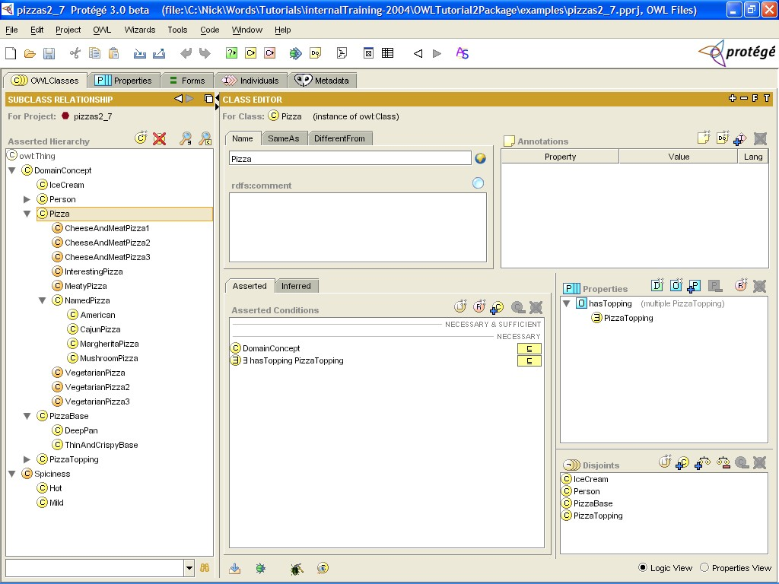
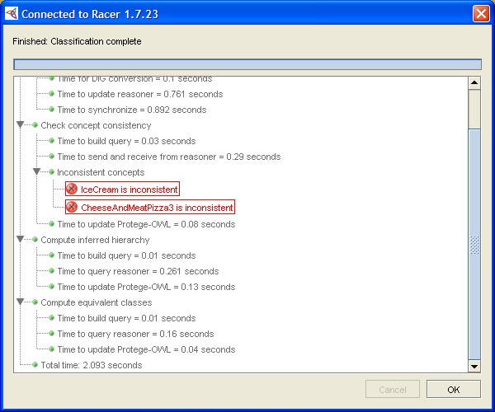
Classifying
Classify taxonomy (and check consistency)
Compute inferred types (for individuals)
Just check consistency (for efficiency)

Slide 11
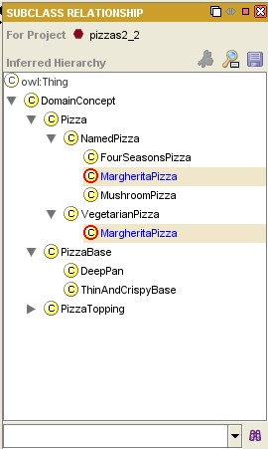
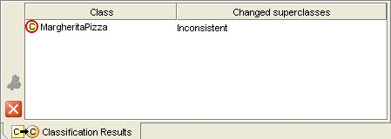
Reasoning about our Pizzas
Start with pizzas2_2.owl
Classify your ontology
You will see an inferred hierarchy appear, which will
show any movement of classes in the hierarchy
You will also see a results window appear at the bottom
of the screen which describes the results of the reasoner
MargheritaPizza turns out to be
inconsistent – why?

Slide 12
Why is MargheritaPizza inconsistent?
We are asserting that a MargheritaPizza is a subclass of two classes we have stated are disjoint
The disjoint means nothing can be a NamedPizza and a VegetarianPizza at the same time
This means that the class of MargheritaPizzas can never contain any individuals
The class is therefore inconsistent

Slide 13
Attempting again
Start with your current ontology
Close the inferred hierarchy
and classification results pane
Remove the disjoint between VegetarianPizza and its siblings
When prompted, choose to remove only between this class and its siblings
Re-Classify your ontology
This should now be accepted by the reasoner with no inconsistencies

Slide 14
Asserted Polyhierarchies
We believe asserting polyhierarchies is bad
We lose some encapsulation of knowledge
Difficult to maintain
let the reasoner do it!

Slide 15
Defined Classes
Have a definition. That is at least one Necessary and Sufficient condition
Are marked in orange in the interface
Classes, all of whose individuals satisfy this definition, can be inferred to be subclasses
Reasoners can perform this inference

Slide 16
Describing a MeatyPizza
Start with pizzas2_3.owl, close the reasoner panes
Create a subclass of Pizza called MeatyPizza
Don’t put in the disjoints or you’ll get the same problems as before
In general, defined classes are not disjoint
Add a restriction to say:
“Every MeatyPizza must have at least one meat topping”
Classify your ontology
What happens?

Slide 17
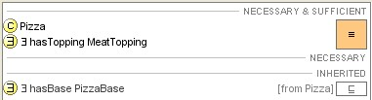
Defining a MeatyPizza
Start with pizzas2_4.owl, close the reasoner panes
Click and drag your ∃ hasTopping MeatTopping restriction from “Necessary” to “Necessary & Sufficient”
The MeatyPizza class now turns orange, denoting that it is now a defined class
Click and drag the Pizza Superclass from “Necessary” to “Necessary & Sufficient”
Make sure when you release you are on top of the existing restriction otherwise you will get 2 sets of conditions.
You should have a single orange
icon on the right stretching across
both conditions like this…
Classify your ontology
What happens?

Slide 18
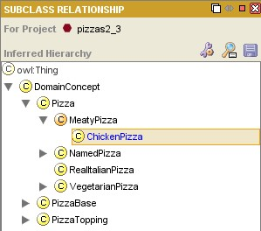
Reasoner Classification
The reasoner has been able to infer that anything that is a Pizza that has at least one topping from MeatTopping is a MeatyPizza
Therefore, classes fitting this definition are found to be subclasses of MeatyPizza, or are subsumed by MeatyPizza
The inferred hierarchy is updated to reflect this and moved classes are highlighted in blue

Slide 19
How do we Define a Vegetarian Pizza?
Nasty
Define in words?
  “a pizza with only vegetarian toppings”?
  “a pizza with no meat (or fish) toppings”?
  “a pizza that is not a MeatyPizza”?
More than one way to model this

Slide 20
Defining a Vegetarian Topping
Start with pizzas2_5.owl
Create a subclass of PizzaTopping
called VegetarianTopping
Click “Create New Expression” in the Conditions Widget
Type in or select each of the top level PizzaToppings that are not meat or fish (ie DairyTopping, FruitTopping etc) and between each, type the word “or”
the “or” will be translated into a union symbol
Press Return when finished
you have created an anonymous class described by the expression
Make this a defined class by moving both conditions from the “Necessary” to the “Necessary & Sufficient” conditions
Classify your ontology

Slide 21
Class Constructors: Union
AKA “disjunction”
This OR That OR TheOther
(This That TheOther)
Set theory
Commonly used for:
  Covering axioms (like VegetarianTopping)
  Closure

Slide 22
Covering Axioms
Covered class – that to which the condition is added
Covering classes – those in the union expression
A covering axiom in the “Necessary & Sufficient” Conditions means:
the covered class cannot contain any instances from a class other than one of the covering classes
Gender
Gender ≡ Female Male
In this example, the class Gender is “covered” by Male or Female
All individuals in Gender must be individuals from Male or Female
There are no other types of Gender
Male
Female

Slide 23
Vegetarian Pizza attempt 2
Start with pizzas2_6.owl
Select MargheritaPizza and remove
VegetarianPizza from its superclasses
Select VegetarianPizza and create a restriction to say that it
“only has toppings from VegetarianTopping”
Make this a defined class by moving all conditions from “Necessary” to “Necessary & Sufficient”
Make sure when you release you are on top of the existing restriction otherwise you will get 2 sets of conditions.
You should have a single orange icon on the right stretching across both conditions
Classify your ontology
What happens?

Slide 24
Open World Assumption
The reasoner does not have enough information to classify pizzas under VegetarianPizza
Typically several Existential restrictions on a single property with different fillers – like primitive pizzas
Existential should be paraphrased by “amongst other things…”
Must state that a description is complete
We need closure for the given property
This is in the form of a Universal Restriction with a Union of the other fillers using that property

Slide 25
Closure
Example: MargheritaPizza
All MargheritaPizzas must have:
at least 1 topping from MozzarellaTopping and
at least 1 topping from TomatoTopping and
only toppings from MozzarellaTopping or TomatoTopping
The last part is paraphrased into
“no other toppings”
The union closes the hasTopping property on MargheritaPizza

Slide 26
Closing Pizza Descriptions
Start with pizzas2_7.owl
Select MargheritaPizza
Create a Universal Restriction on the hasTopping property with a filler of “TomatoTopping MozzarellaTopping”
Remember, you can type “or” to achieve this, or you can use the expression palette
Close your other pizzas
Each time you need to create a filler with the union of all the classes used on the hasTopping property (ie all the toppings used on that pizza)
Classify your ontology
Finally, the defined class VegetarianPizza should subsume any classes that only have vegetarian toppings

Slide 27
Summary
You should now be able to:
Use Defined Classes allow a polyhierarchy to be computed
Classify and check consistency using a Reasoner
Create Covering Axioms
Close Class Descriptions to cope with Open World Reasoning

Slide 28
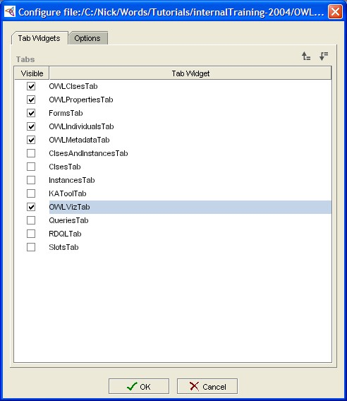
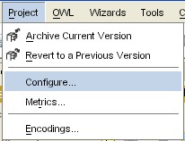
Viewing our Hierarchy Graphically

Slide 29
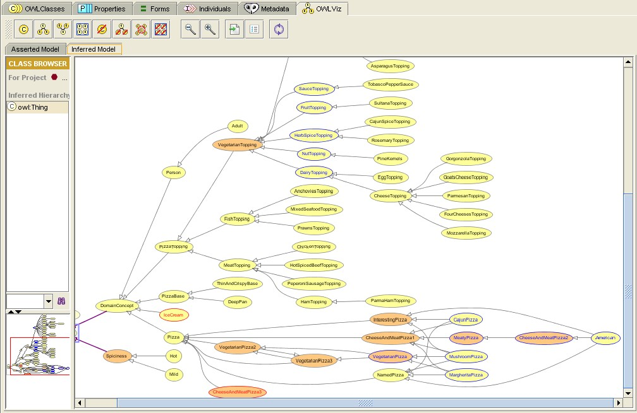
OWLViz Tab
View Asserted Model
View Inferred Model
Polyhierarchy
tangle

Slide 30
Your Pizza Finder
Once you have a pizza ontology you are happy with, you can “plug it in” to the PizzaFinder
Instructions available on line at…

Slide 31
Other Exercises:
Create a ProteinLoversPizza
Start with pizzas2_8.owl
Create a new subclass of Pizza
Define this as:
“Any Pizza that has at least one MeatTopping and at least one CheeseTopping and at least one FishTopping”
If you don’t have any pizzas that will classify under this, create one which should (SicilianaPizza should)
Classify to check that it works

Slide 32
Other Exercises:
Define RealItalianPizza
Start with pizzas2_9.owl
Convert RealItalianPizza to a defined class
Add information to your pizzas to allow some of them to classify under this one
Classify
remember to check your disjoint if you have problems

Slide 33
Thankyou
Feedback on tutorial appreciated
Powerpoint slides available from
- http://www.cs.man.ac.uk/~drummond/cs646
Software / resources / community at:
  http://www.co-ode.org/
  http://protege.stanford.edu/

